Slide 1






Automated Tools
For System Analysis and Design

Slide 2
Group Members
01
02
03
04
05
Nguyễn Thị Ngọc Ánh
1801040015
Nguyễn Thu Trang
1801040226
Nguyễn Thị Thảo
1801040209
Nguyễn Thị Ngà
1801040159
Trịnh Quang Huy
1801040106

Slide 3
1
Introduction to CASE
The Use of CASE in Organizations
2
Automated Tools
for
SAD
3
Components of CASE
CASE Tools
4
5
CASE-Based Systems Development

Slide 4


PART 1
CASE

Slide 5
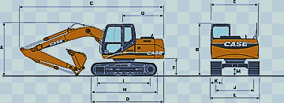
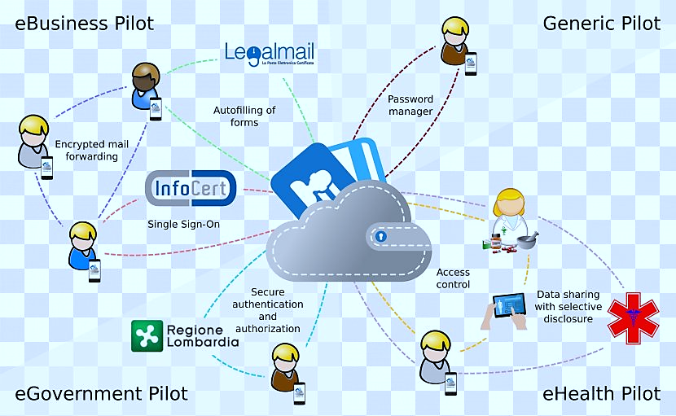

Automated software tools used by systems analysts to develop information systems
Computer-aided Software Engineering
support or automate activities throughout SDLC
Notes:
Automated software tools used by systems
analysts to develop information systems
Used to support or automate activities throughout the systems development life cycle (SDLC)
Increase productivity
Improve overall quality of systems

Slide 6



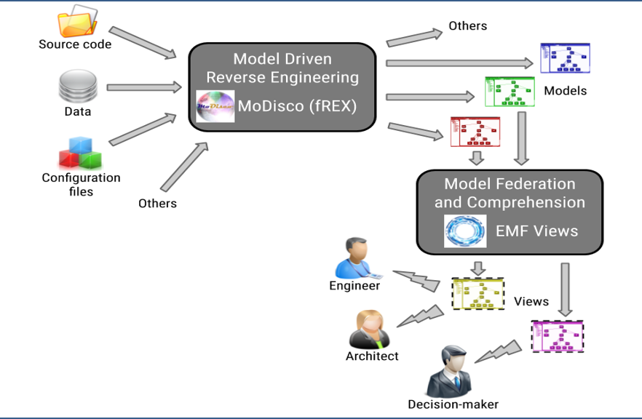
Categories of CASE Products
an artificial object
deconstructed
reveal designs, architecture,
code, extract knowledge from the object
Notes:
Reverse engineering, also called backwards engineering or back engineering, is the process by which an artificial object is deconstructed to reveal its designs, architecture, code or to extract knowledge from the object. It is similar to scientific research, the only difference being that scientific research occurs for a natural phenomenon
Reverse engineering is applicable in the fields of computer engineering, mechanical engineering, electronic engineering, software engineering, chemical engineering,^{[2]} and systems biology.

Slide 7
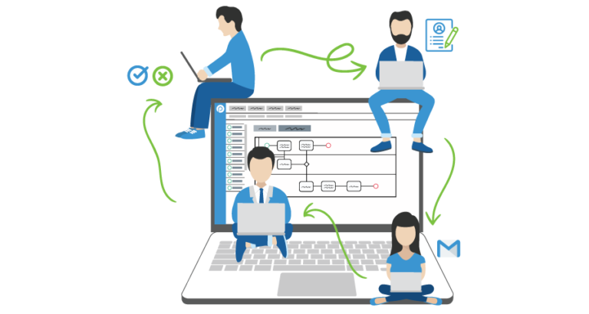



redesigning jobs, careers, processes
enhance quality, service, speed
Notes:
Reengineering or Reconstruction is the fundamental rethinking and radical redesign of business processes to achieve dramatic improvements in critical contemporary measures of performance.
Re-engineering is also known as process management, process renewal or process redesign - involves redesigning jobs, careers, and processes with the aim of enhancing quality, service and speed.

Slide 8


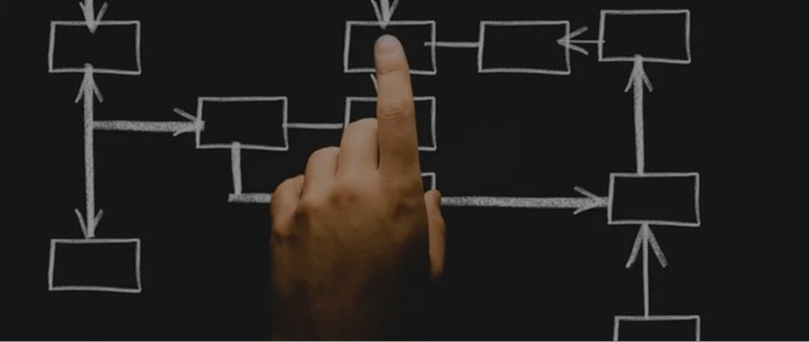
PART 2
The Use of CASE in Organizations

Slide 9
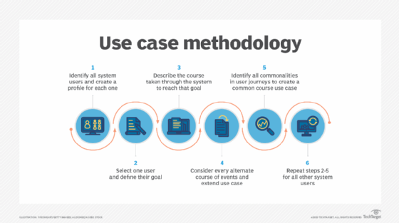
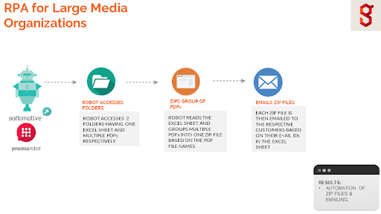
quality and completeness of documentation
project management
testing process
portability
quality of systems
speed
maintenance
reusability
Notes:
Improve quality of systems developed
Increase speed of development and design
Improve testing process through automated checking
Improve quality and completeness of documentation
Improve project management
Simply program maintenance
Promote reusability
Improve software portability

Slide 10
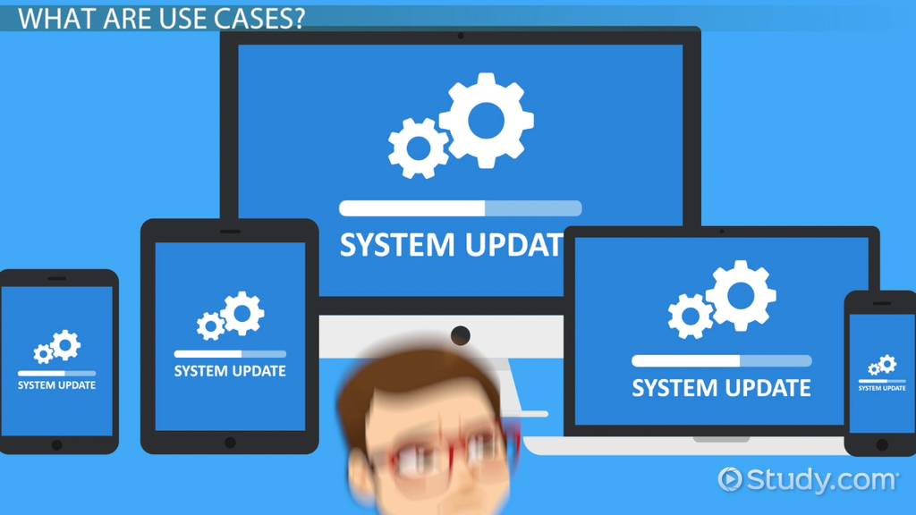

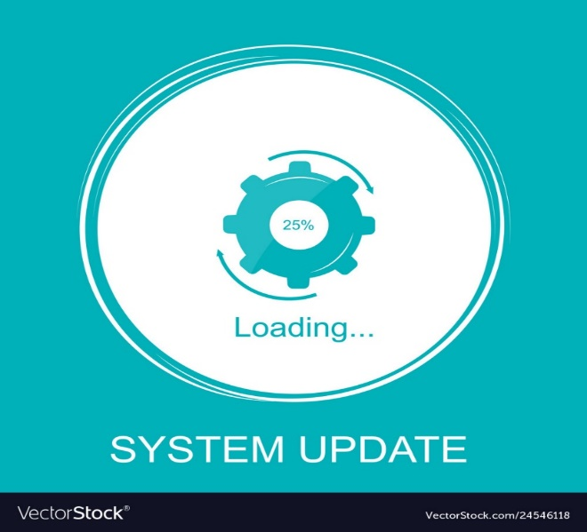
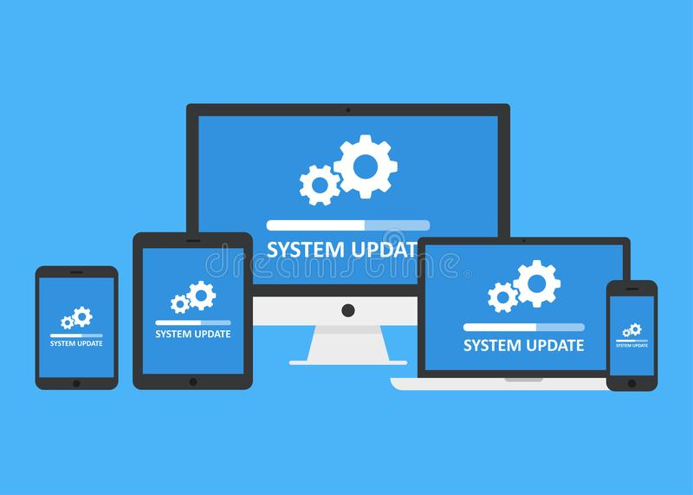
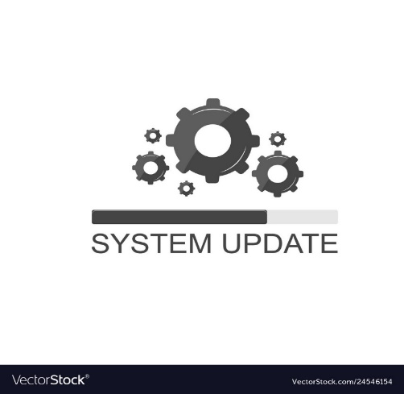

CASE and System Quality
Majority of organizations adopt CASE to improve speed and quality of systems development projects.
Widespread deployment has been slower than expected.
Notes:
Majority of organizations adopt CASE to improve speed and quality of systems development projects.
Widespread deployment has been slower than expected.
Several factors that inhibit widespread deployment

Slide 11

$
Cost
Return on Investment
$5,000 - $15,000
Biggest benefits of CASE come in late stages of SDLC
CASE tools one systems analyst
Productivity Bottlenecks
Difficulty in providing tools for all states of SDLC

Slide 12

Components of CASE
PART 3

Slide 13
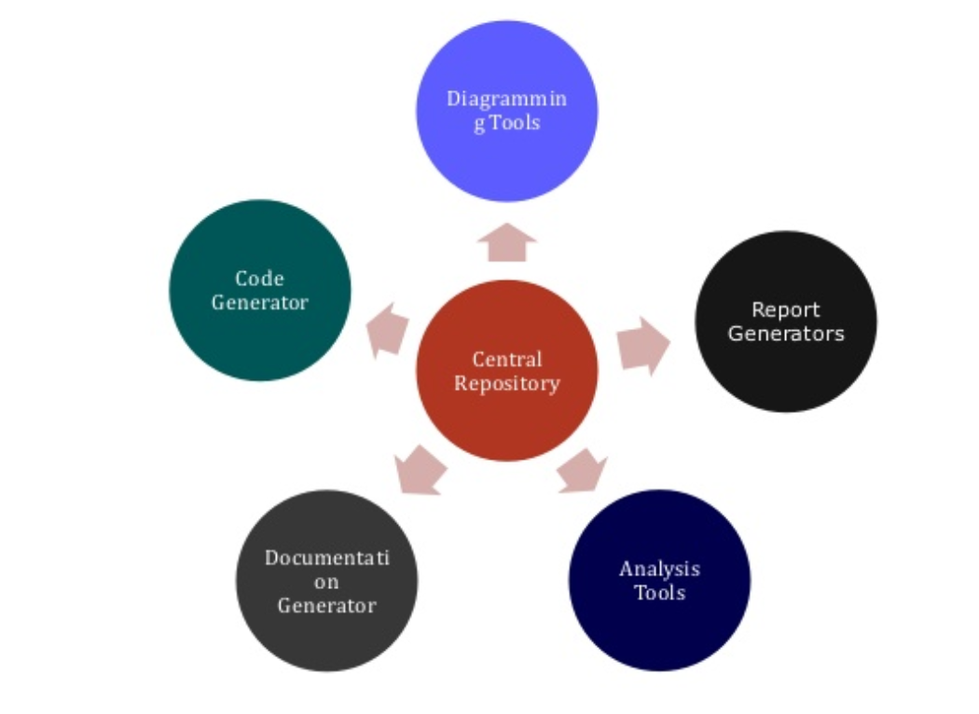
Real CASE Tools
support several phases
of
development
Classic CASE Tools
interactive debuggers
Notes:
We must distinguish between ‘classic’ case tools and ‘real’ case tools:
+ Classic CASE tools: interactive debuggers. Compilers, project progress control systems
+ Real CASE tools: support several phases of development

Slide 14

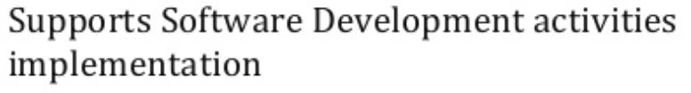


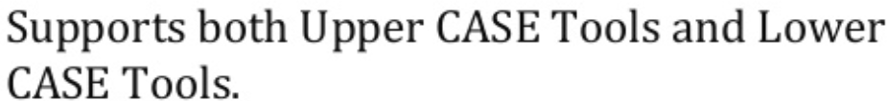
Supports Software Development activities implementation
Supports Programming and Integration Tasks
Supports both Upper CASE Tools and Lower CASE Tools
Notes:
Real Case Tools: There are several components are based on their usage in different stages of the software development life cycle:
+ Upper CASE tools support analysis and design
+ Lower CASE tool refer to the location in these phases in the Waterfall Model
+ Cross life-cycle CASE or Integrated CASE tools: combine both upper and lower, support analysis, design, and coding Central Repository: A central repository is required by the tools to serve as a common source of integrated and consistent information.

Slide 15
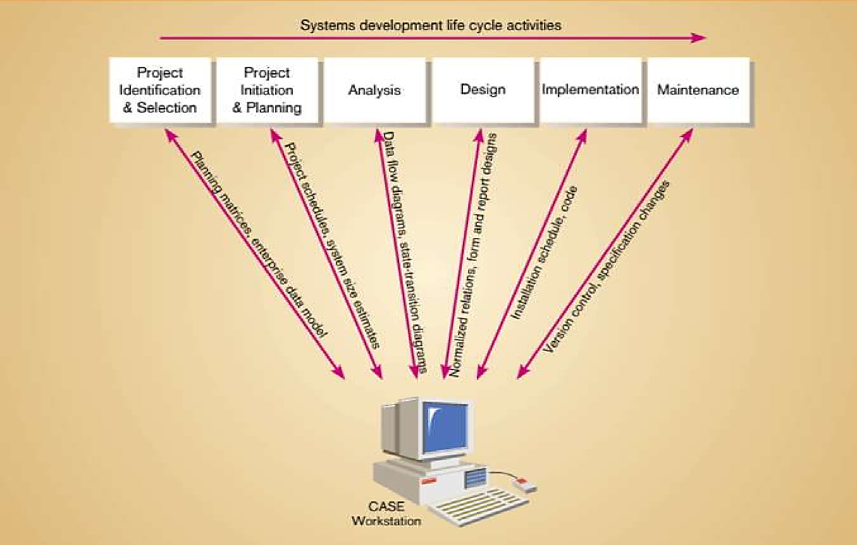
CASE Supports
Notes:
Software tools designed to support activities of system development cycle:
In the first phase all the requirement are collected from customer/client. They are provided in a document called Businessmen requirement specification and System requirement specification. All the detail are discuss with customer/client in detail.
Initiating a project includes recognizing and starting a new project or project phase
The main purpose of project planning is to guide execution
Analysis is carried out to verify the entire system. The aim of the tester is to find out the gaps and defects within the system and also to check whether the system is running according to the requirement of the customer/client.
Design: has two steps: High level design : It give the architecture of software product.
Low level design It describe how each and every feature in the product should work and every component.
Implementation:
This is the longest phase.
This phase consists of Front end + Middle ware + Back-end
Maintenance: Once the product has been delivered to the client a task of maintenance start as when the client will come up with an error the issue should be fixed from time to time.

Slide 16
PART 4

Slide 17
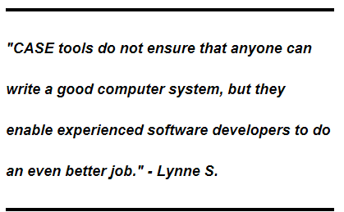
Top 13 Types of CASE Tools
Diagram Tools
Design Tools
Analysis Tools
Prototyping Tools
Programming Tools
CASE Tools
Maintenance Tools
Documentation Tools
Change Control Tools
Web Development Tools
provide the ways that can fulfill the requirements of software developers
Quality Assurance Tools
Process Modeling Tools
Project Management Tools
Configuration Management Tools
Notes:
Software developers always looking for such CASE tools that help them in many different ways during different development stages of software
They can understand the software and prepare a good end product that efficiently fulfill the user requirements
CASE tools provide the ways that can fulfill the requirements of software developers
These tools provide computerized setting to software developers to analyze a problem and then design its system model

Slide 18
Design
Process Modeling
Change Control
Programming
Documentation
Analysis
Diagramming
Prototyping
Configuration
Project Management
Quality Assurance
Maintenance
Web Development
Notes:
Diagramming tools– graphical representation of system components, data and control flow among various software components;
Process modeling tools – create a software process model used to develop the software;
Project management tools – project planning, cost and effort estimation, project scheduling and resource planning.
Documentation tools – generate detailed documents for technical users and end-users describing the function and how-to of the system such as user manual.
Analysis tools – gather requirements, automatically check for inaccuracy and data redundancies.
Design tools – design the block structure of the software, then divide it into modules, provide the details for each module and interconnections among modules.
Configuration management tools – version and revision management, change control management through automatic tracking, version management, and release management.
Change control tools – deal with changes made to the software, automate change tracking, file management, code management an enforce organization change policy.
Programming tools – providing comprehensive aid in building a software product and include features for simulation and testing.
Prototyping tools – provides initial look and feel of the product and simulates a few aspects of the actual product. Also, they help us build rapid prototypes based on existing information.
Web development tools – assist in designing web pages and all their consisting elements, like forms, text, script, graphics.
Quality assurance tools – monitoring the engineering process and methods, in order to ensure conformance of quality as per organization standards.
Maintenance tools – show modifications in the software product after it goes into production. Therefore, automatic logging, error reporting techniques, or automatic error ticket generation.

Slide 19
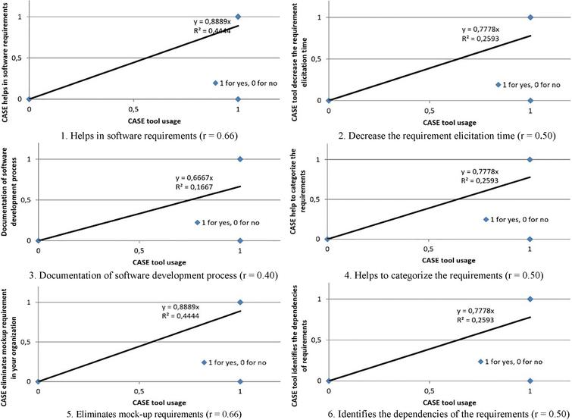
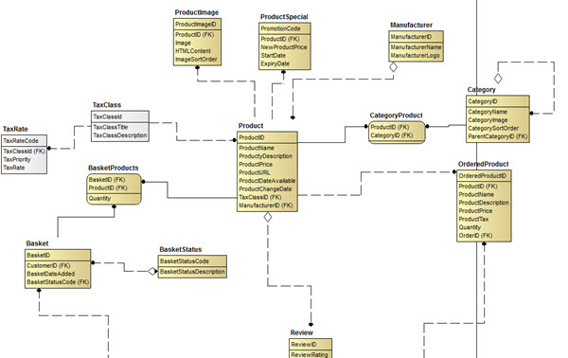
Analysis CASE tools
Entity relationship CASE tools
Notes:
There are some examples of types
Data flow diagrams
Entity relationship diagrams

Slide 20
CASE Form & Report Generator Tools
Two Purposes:
Create, modify and test prototypes of computer display forms and reports
Identify which data items to display or collect for each form or report

Slide 21
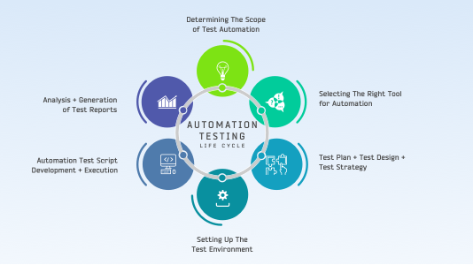


Advantages of the CASE approach
Why is CASE important?
CASE allows for rapid development of software
Notes:
CASE allows for rapid development of software because of the increasing speed of changing market-demands new products replace old ones much earlier than before so the development of new products has to go faster

Slide 22
Collect data quickly
Reduce time and effort
CASE
Standardization
Reusable
Automatically
Notes:
Advantages of the CASE approach:
As special emphasis is placed on redesign as well as testing, the servicing cost of a product over its expected lifetime is considerably reduced.
The overall quality of the product is improved as an organized approach is undertaken during the process of development.
Chances to meet real-world requirements are more likely and easier with a computer-aided software engineering approach.
CASE indirectly provides an organization with a competitive advantage by helping ensure the development of high-quality products.

Slide 23
Difference between CASE-Based Systems Development and Traditional Systems Development
PART 5

Slide 24

Traditional System Development Methods
Technology Dependence Problems
Solution Consideration
Notes:
Systems requirements have typically been defined by IT staff, by interviewing users to determine their operational business needs.
The business needs have been difficult to determine. If these needs are not understood or expressed clearly, the designed systems may not address the real needs of the users and management
The systems that are to be developed for the future must support the corporate goals. This is the most common systems development problem today

Slide 25
Weaknesses of Traditional Systems
Development
No support
for integration of
documents
Documentation after coding
Out-of-date documentation
Notes:
Traditional approach does not offer support for integration of specification document
Often, documentation is done after coding is completed in traditional systems development
And traditional approach often leads to out-of-date documentation

Slide 26
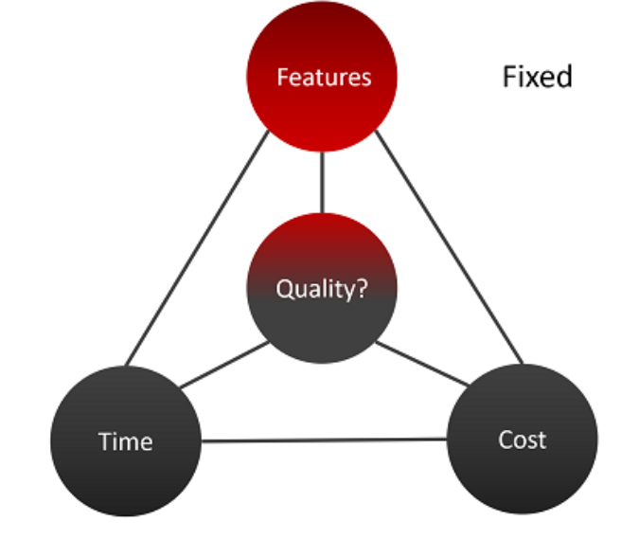


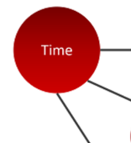




Traditional Systems Development
CASE-Based Systems Development
Notes:
Traditional Systems Development:
Emphasis on coding and testing
Paper-based specifications
Manual coding of programs
Manual documenting
Intensive software testing
Maintain code and documentation
while CASE-Based Systems Development:
Emphasis on analysis and design
Rapid interactive prototyping
Automated code generation
Automated documentation generation
Automated design checking
Maintain design specification

Slide 27


